Slide 1


K.RAMAKRISHNAN COLLEGE OF ENGINEERING
(AUTONOMOUS)
ECB1204 - ANALOG INTEGRATED CIRCUITS
TITLE : AUTOMATIC CURTAIN CLOSER

Slide 2
ABSTRACT
The Automatic Curtain Closer is a smart home automation system designed to provide convenience, energy efficiency, and enhanced security. This system automatically opens and closes curtains based on environmental factors such as light intensity, time of day, or user preference. Using sensors like the LDR (Light Dependent Resistor) and a microcontroller such as Arduino, the system detects the surrounding light level and triggers a motor to operate the curtain accordingly. During bright daylight, the curtains open to allow natural light, while in dim conditions or at night, they close automatically to maintain privacy. This project reduces the need for manual operation, saves energy by optimizing natural lighting, and improves comfort in modern households. It can also be integrated with IoT technology for remote control through smartphones, making it a practical and cost-effective solution for smart living environments.

Slide 3
COMPONENTS REQUIRED
IC 2822A
LDR
10KΩ Resistors (2 )
DC Motor
Capacitors
Power Supply (VCC)
Connecting Wires
Breadboard
Curtain Mechanism ( Pulley System)

Slide 4
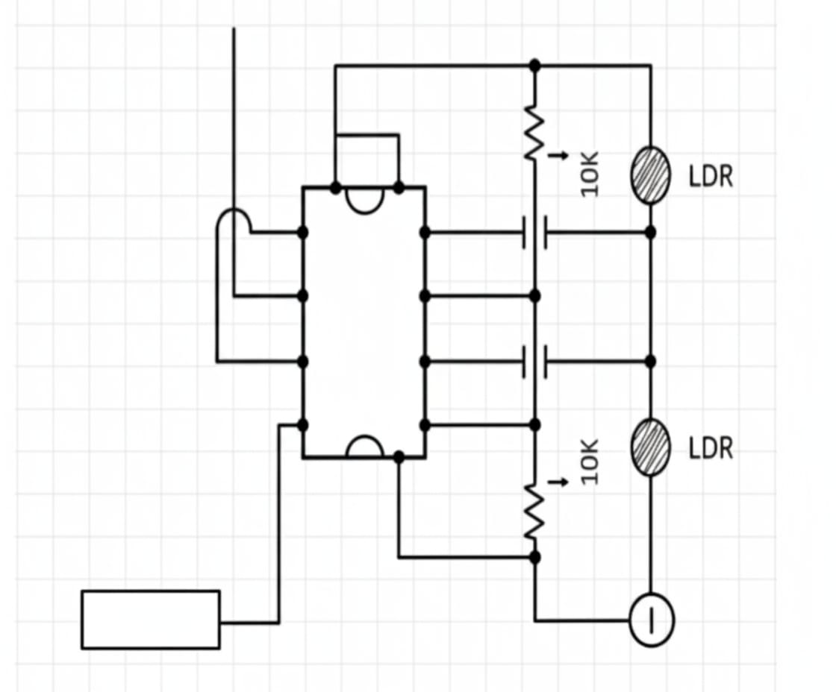
CIRCUIT DESIGN
lithium-ion battery
MOTOR
1234
8
7
6
5
BATTERY

Slide 5
CIRCUIT DESIGN EXPLANATION
The circuit uses an IC 2822A as the main control unit to operate the curtain based on the surrounding light intensity.
It is powered by a lithium-ion battery, which supplies DC voltage to the IC and the 10Ω DC motor.
Two Light Dependent Resistors (LDRs) are connected with 10kΩ resistors to form a voltage divider network that detects the ambient light level.

Slide 6
When the light intensity decreases (dark condition), the LDR resistance increases, raising the voltage at the IC input → the IC output (pin 5) becomes HIGH, activating the motor.
The motor then rotates and closes the curtain automatically using the mechanical linkage.
As brightness returns, the LDR detects the light, reducing its resistance → the IC output turns LOW, stopping the motor and leaving the curtain open.
This automatic operation demonstrates how the circuit can save energy, increase comfort, and reduce manual effort in daily life.

Slide 7
WORKING PRINCIPLE
Power Supply:
A rechargeable lithium-ion battery provides a stable DC voltage to the entire circuit. It powers the IC 2822A, the DC motor, and the LDR sensor, ensuring smooth and continuous operation without external power.
Control Circuit:
The main control circuit is built on a breadboard using the IC 2822A, resistors, and the LDR sensor. The IC processes the voltage from the LDR and decides whether to turn the motor ON or OFF based on the surrounding light intensity.
LDR Function:
The Light Dependent Resistor (LDR) changes its resistance depending on light levels. In bright light, its resistance is low, keeping the motor OFF and the curtain open. When it becomes dark, the resistance increases, signaling the IC to activate the motor and close the curtain.

Slide 8
DC Motor Setup:
The DC motor is connected to a simple mechanical setup, such as a pulley or rod, which represents the curtain movement. When the motor receives power, it rotates and pulls the curtain closed automatically, demonstrating the closing mechanism clearly.
Operation:
During darkness, the LDR senses the drop in light intensity, the IC output becomes HIGH, and the motor closes the curtain. When daylight returns, the LDR resistance decreases, turning the IC output LOW and stopping the motor, leaving the curtain open. This ensures automatic operation without manual effort.

Slide 9
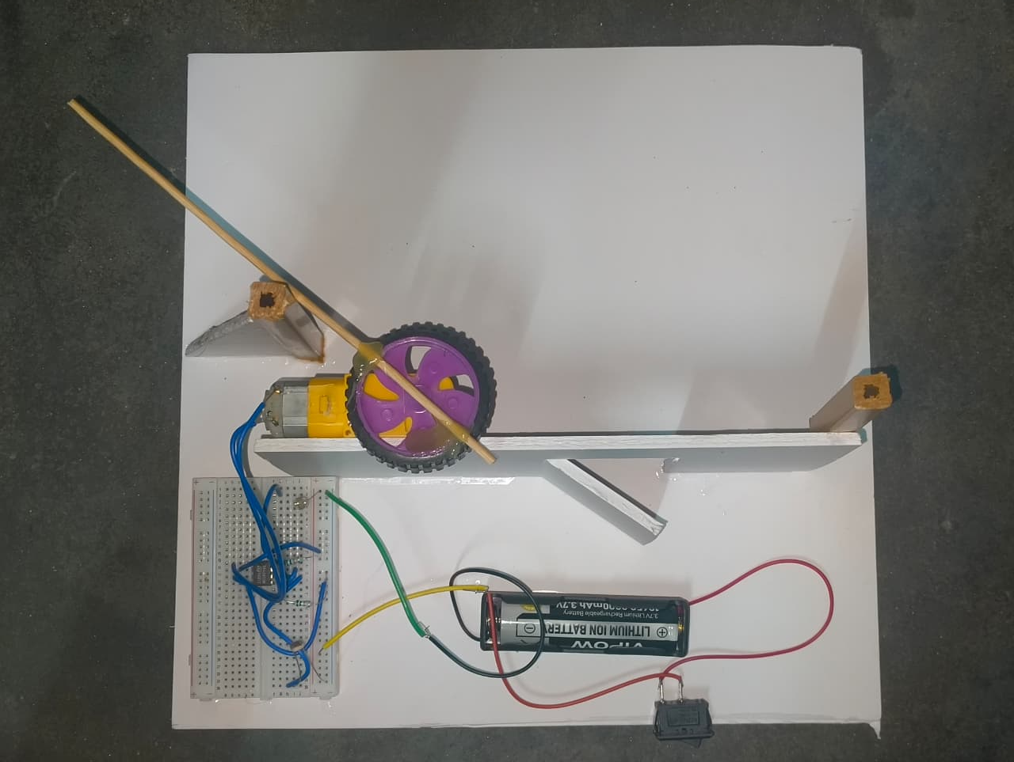
RESULT AND DISCUSSION

Slide 10
The Automatic Curtain Closer system successfully detects variations in ambient light intensity and automatically operates the curtain based on the detected light levels. During bright daylight, the LDR senses high light intensity, causing the motor to rotate and open the curtain, allowing natural light to enter the room. As the surrounding light decreases during the evening or in darkness, the resistance of the LDR increases, which triggers the motor to rotate in the opposite direction, thereby closing the curtain. The circuit responded accurately to changes in light conditions and operated the motor smoothly without manual control. This project effectively demonstrates the concept of home automation by enhancing comfort, saving energy, and reducing human effort through automatic curtain operation.

Slide 11
CONCLUSION
The Automatic Curtain Closer system provides an efficient, user-friendly, and innovative approach to home automation. By automatically controlling the movement of curtains based on environmental conditions or user settings, it enhances comfort, privacy, and energy conservation. The use of sensors and a microcontroller ensures reliable and precise operation without human intervention. This project demonstrates how simple automation can significantly improve daily living convenience while reducing energy usage. With further development, such as IoT integration and mobile control, the system can become an essential feature in smart homes, contributing to a more sustainable and modern lifestyle.

Slide 12
FUTURE SCOPE
IoT Integration: The system can be connected to the Internet of Things (IoT) to enable remote control through smartphones or voice assistants like Alexa and Google Assistant.
Temperature and Motion Sensors: Additional sensors can be added to respond to room temperature or human presence for better comfort and energy efficiency.
Solar Power Operation: The system can be powered using solar energy to make it more eco-friendly and energy independent.
Advanced Scheduling: A real-time clock (RTC) module can be used to set automatic opening and closing times based on user preferences or sunrise/sunset timings.

Slide 13
REFERENCES
Sedra, A.S. & Smith, K.C. – Microelectronic Circuits, 7th Edition, Oxford University Press, 2015.
Datasheet – IC 2822A Audio Amplifier IC, STMicroelectronics. Available at: https://www.st.com/resource/en/datasheet/tda2822.pdf
Gayakwad, R.A. – Op-Amps and Linear Integrated Circuits, 4th Edition, Prentice Hall, 2001.
Research Paper: Sharma, P., & Verma, S. (2020). “Design and Implementation of Automatic Curtain Control System Using LDR Sensor.” International Journal of Engineering Research & Technology (IJERT), Vol. 9, Issue 5, pp. 456–460.
Electronics Tutorials – “Light Dependent Resistor (LDR) Circuits.” Available at: https://www.electronics-tutorials.ws/io/io_4.html

